Slide 1

CS671 Project
Dhruv Chamaria Tarun Dagar Maanasa Dharini

Slide 2
AGENDA
Introduction
Data And Methods
Results
Conclusion

Slide 3
Introduction
Problem
Use Case
Solution
Manual hand X-ray photo analysis is a very difficult and time-consuming task for the radiologist as well.
Joint detection helps in identifying numerous medical conditions such as
Usually, without computer vision, it is time-consuming to detect these problems our project proposes two methods for joint detection.

Slide 4
Data
Q1
Data Preprocessing
Q2
Understanding Data
Q3
Deciding Method
Q4
Implementation

Slide 5

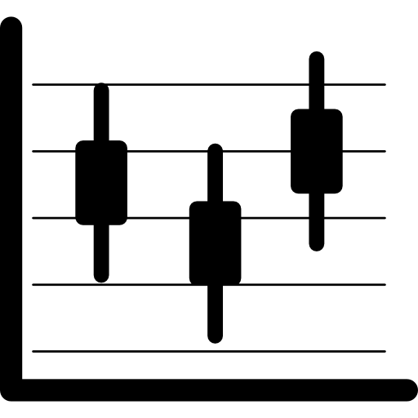


Method 1 (Using image Processing)
Image
Pre-processing
1
2
Histogram Equalization
All images should be at the same level we apply histogram equalization for the same to make dark pixels light and light pixels dark
Pre-process the image to enhance the contrast and improve the visibility of the joints.
Reducing Noise
Hough Transform
There are several techniques you can use, such as thresholding, morphological operations, and contour detection.
3
4
Extract features from the segmented hand joints. We used Hough transform

Slide 6


Method 1 (Using image Processing)
Labelling Data
Training Data
1
2
Data labeling in the format of yolo was a time-consuming task
For training data, we used yolov5 its architecture we trained for 200 epochs with early stopping.
Testing Data
Hough Transform
We performed testing on 10 percent of the images which was used to calculate accuracy using comparing them with the text file provided to us by madam.
3
4
Extract features from the segmented hand joints. We used the Hough transform

Slide 7
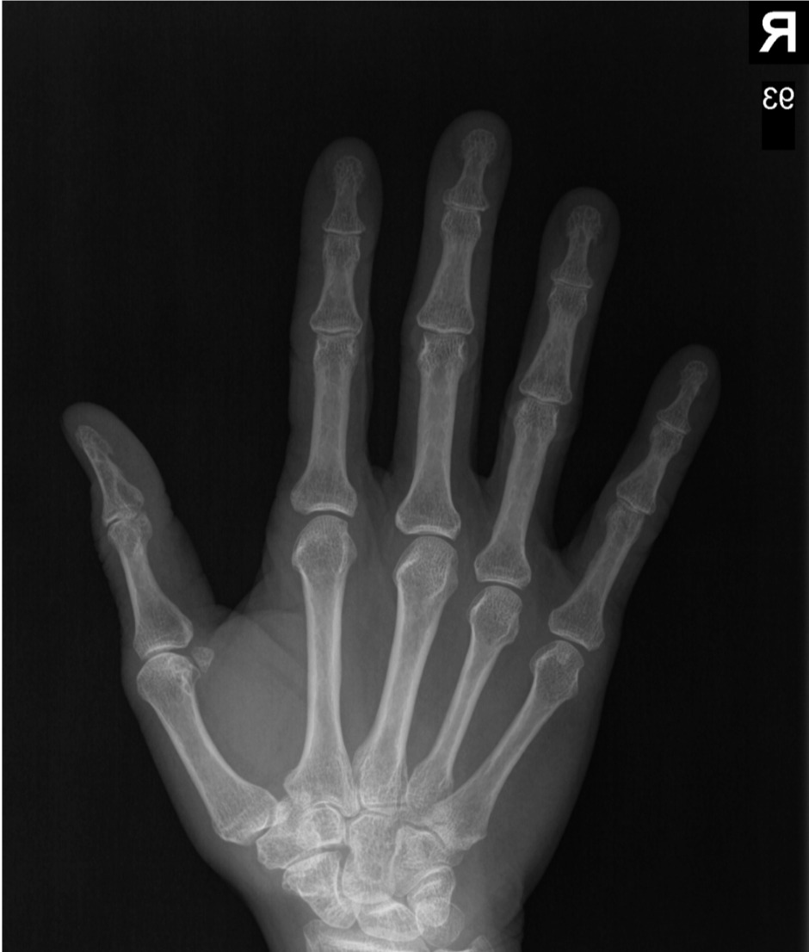
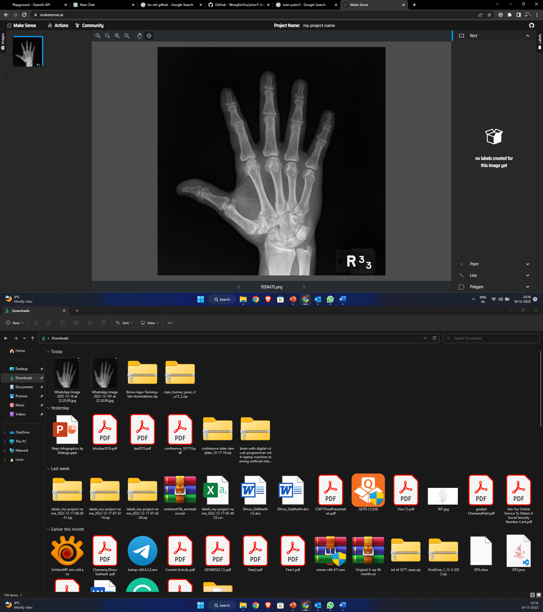
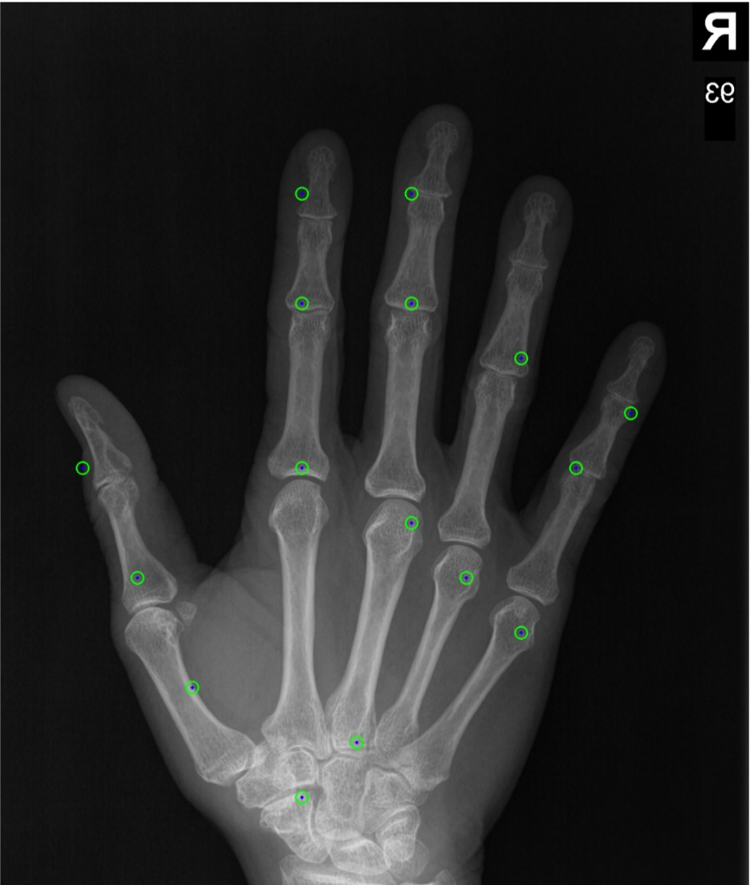
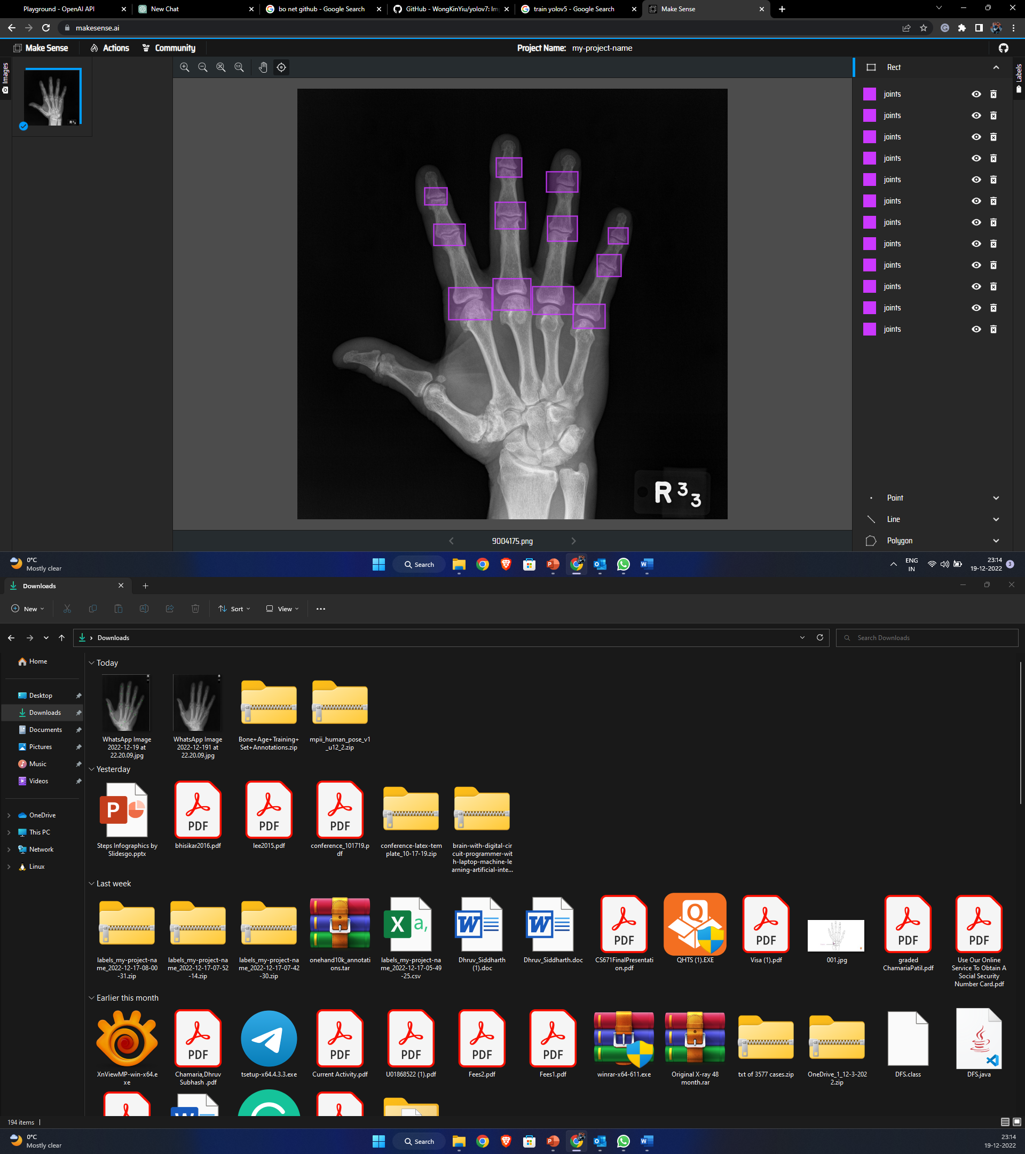
Results
Method 1
Method 2
Image 1 shows the original image, and the second image shows the detected image.
After evaluation, we got an overall accuracy of 60-65 % which is a low accuracy but can be improved further using different image processing techniques.
We were not able to distinguish between the fingers and the thumb
Image 1 shows the original image, and the second image shows the detected image.
After evaluation, using yolo we got an accuracy of around 90-95 percent.

Slide 8
Conclusion
Our method is a fully automated system to detect three different types of joints that in MCP, DIP, and SIP. The results are satisfying and reliable. This system fails to detect joints in which images are blacked out and have improper joint X–ray images. The major challenge is to accurately measure joint localization and apply proper image processing techniques to achieve higher accuracy.

Slide 9
THANK YOU
“Machine intelligence is the last invention that humanity will ever need to make.”
~Nick Bostrom

